Slide 1
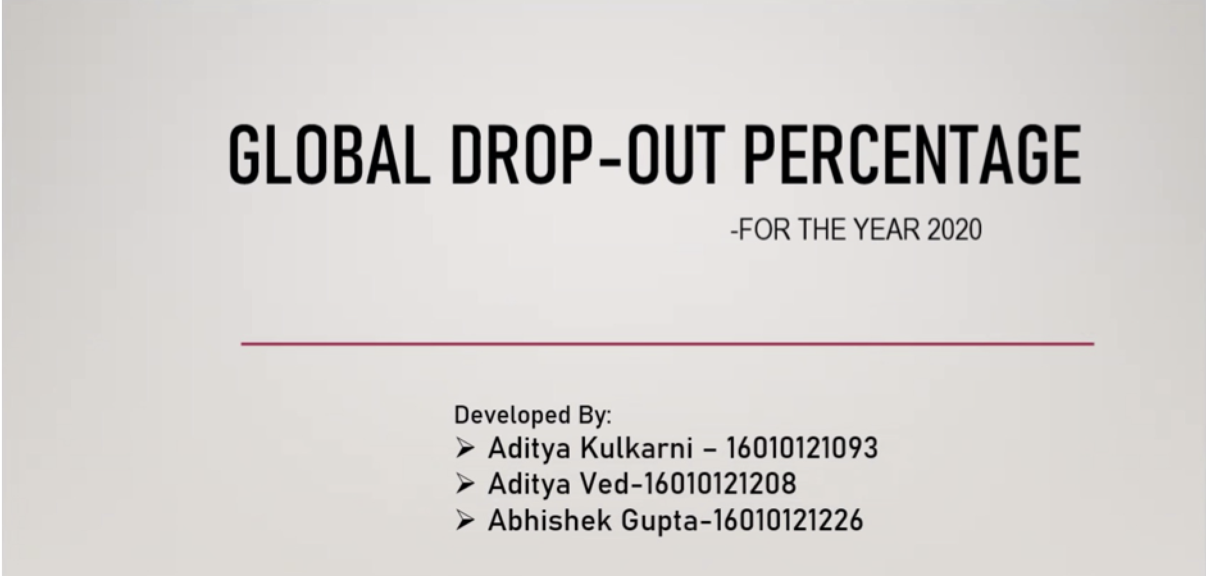

Slide 2
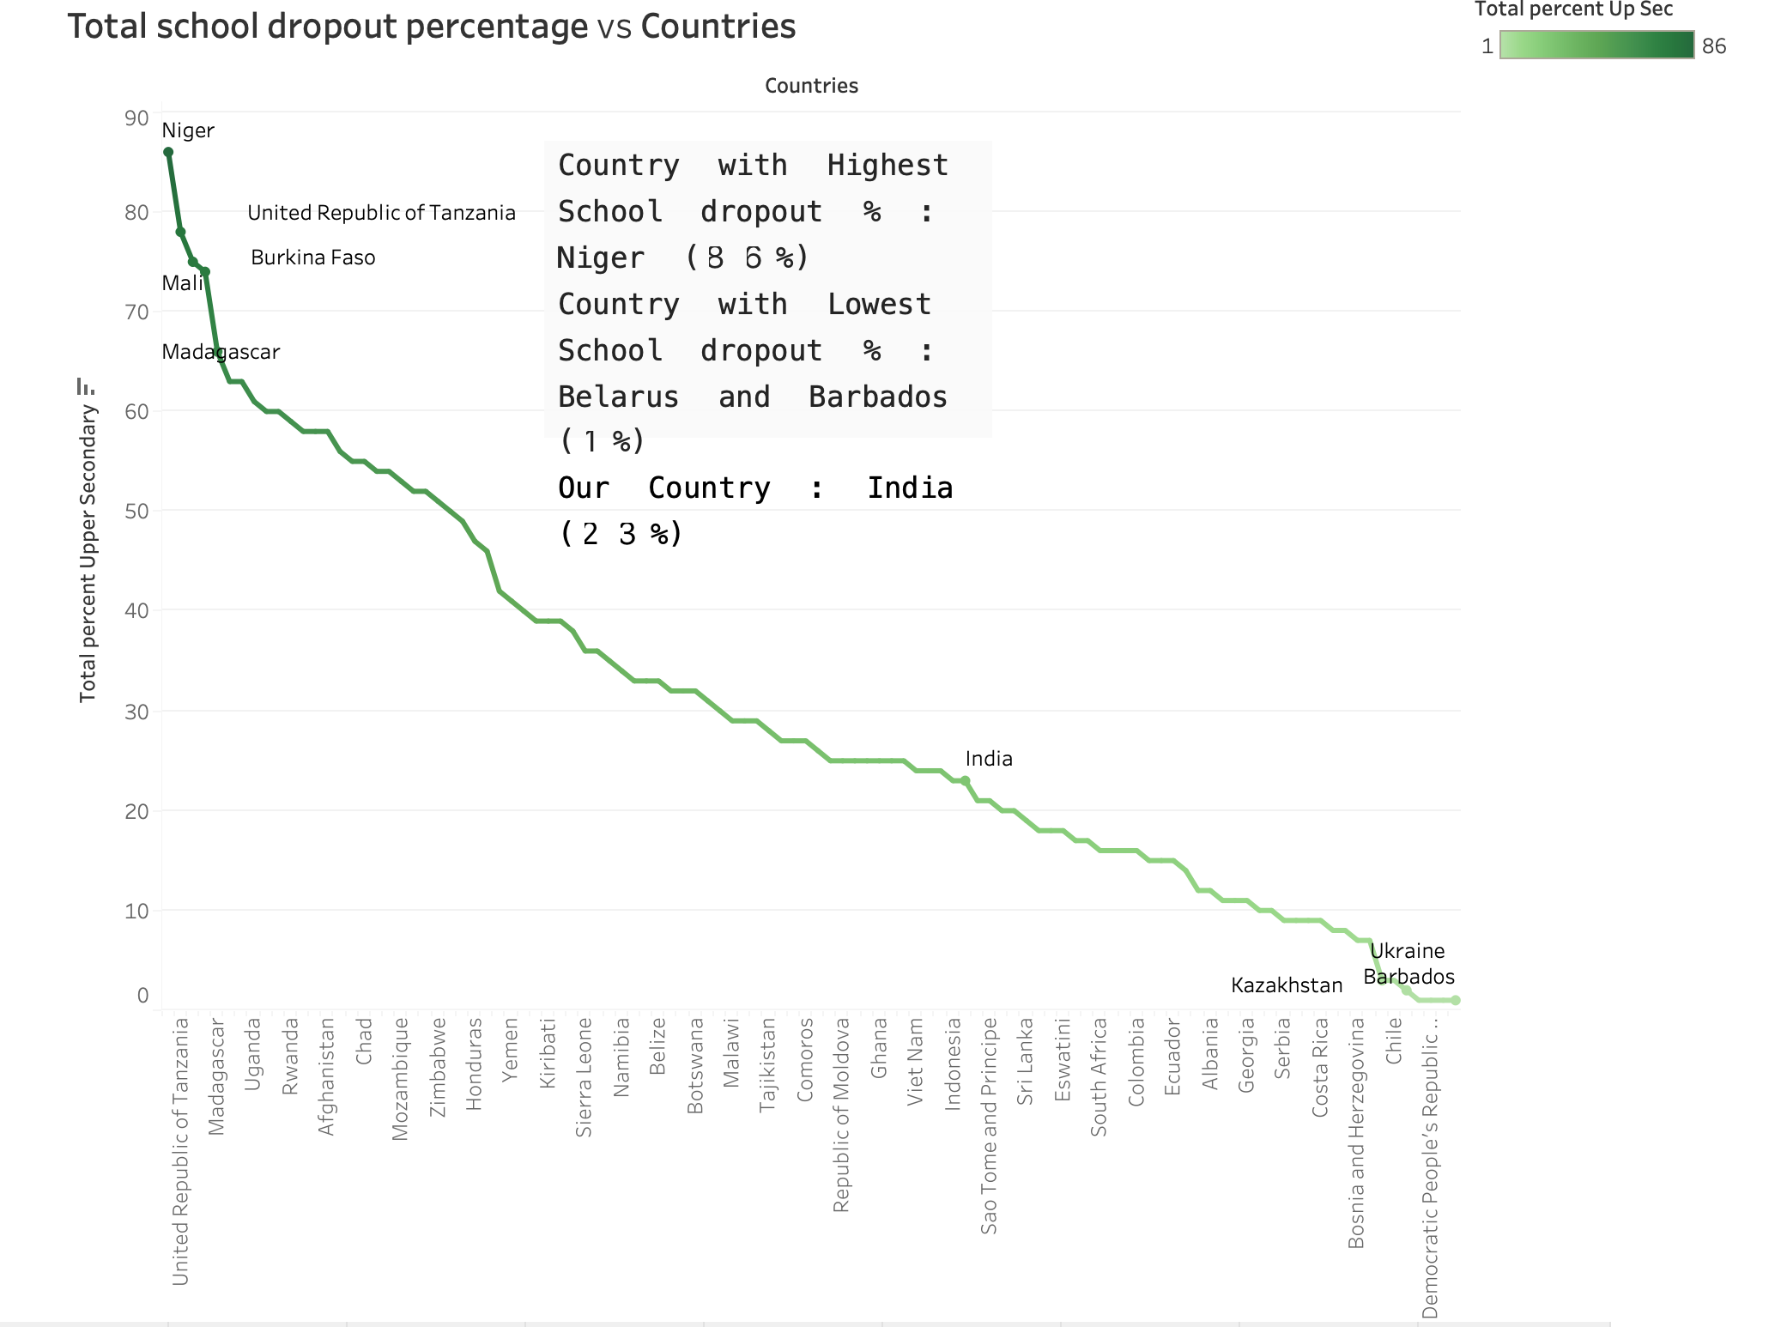

Slide 3
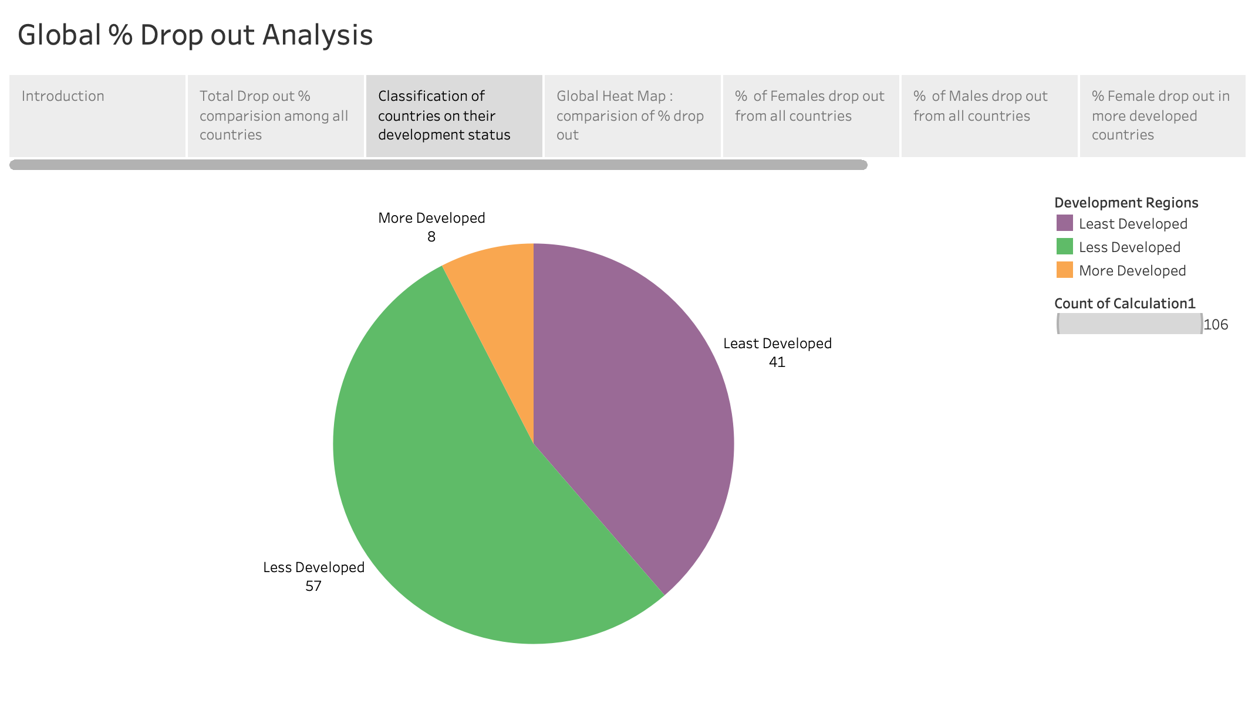

Slide 4
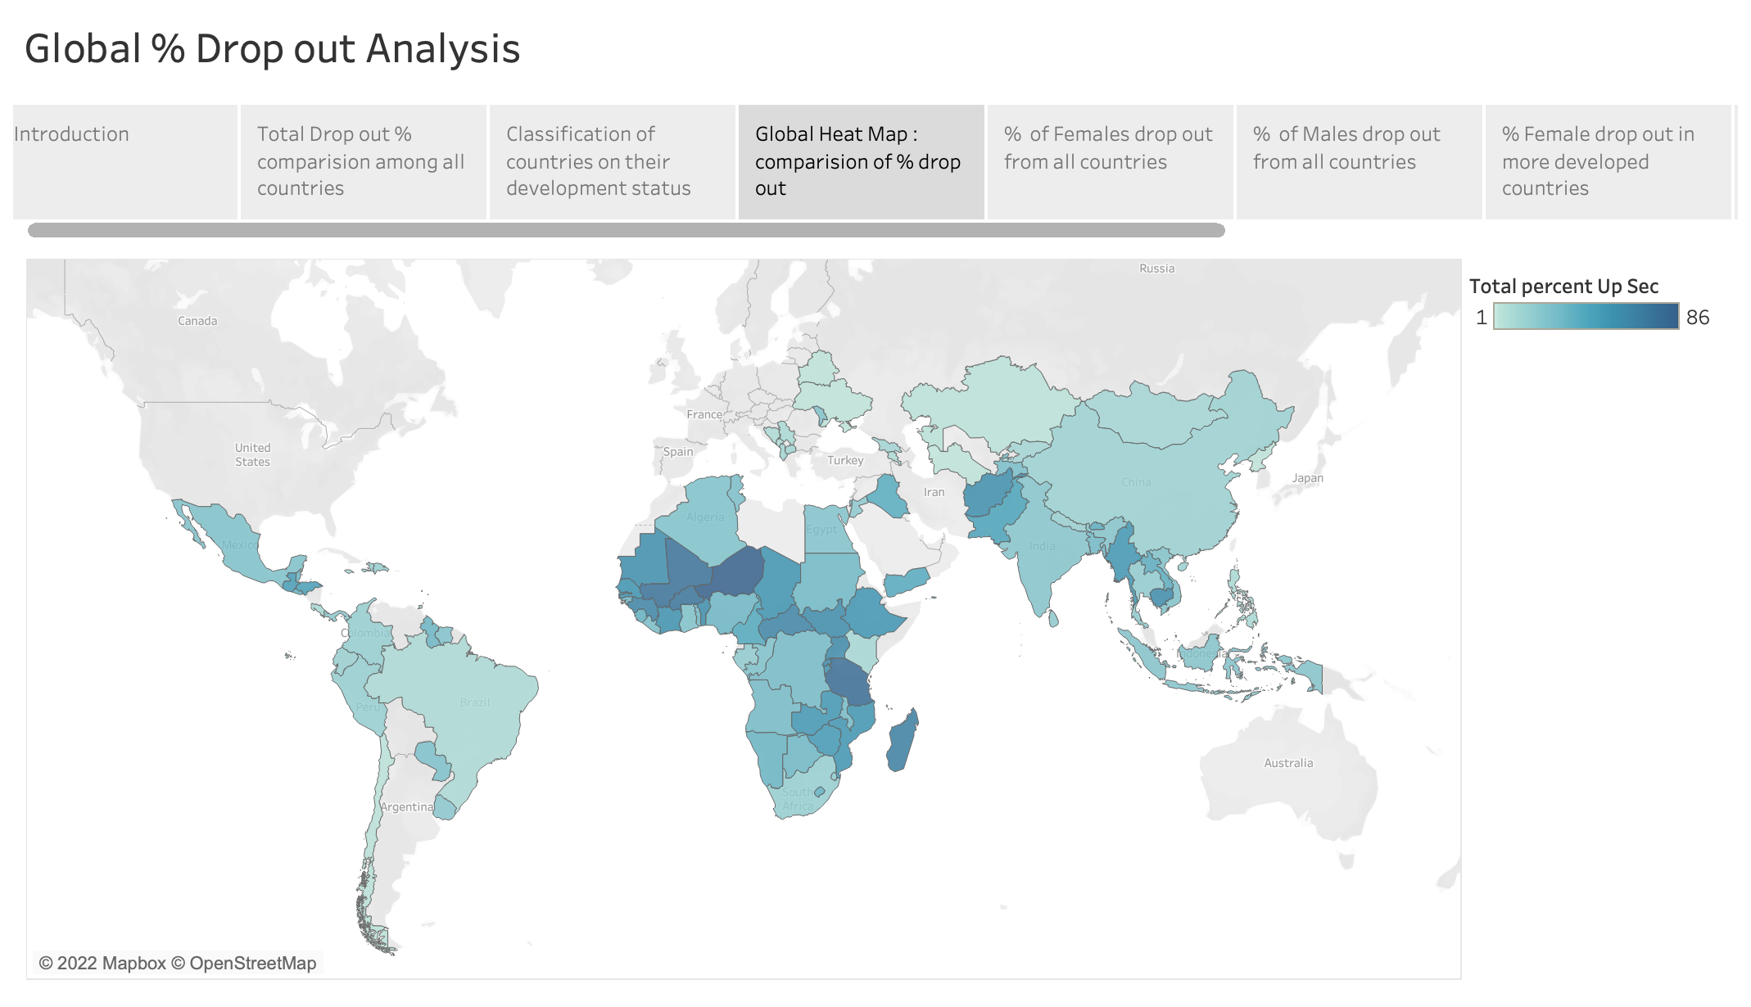

Slide 5
Global heat map analysis :
African continent analysis : More minerals ==> more Mafias ==> less life span ==> less education
Factors :
Number of Schools/Colleges
Government supporting policies
Political Stability
India vs Pakistan : neighbourhood contrast analysis :
India : 42,343 colleges
Pakistan : 6100 colleges
ratio of population :: India : Pakistan = 6 : 1
ratio of colleges :: India : Pakistan = 7 : 1
Huge Multiplying effect

Slide 6
Analyzing less developed and more developed countries
dropout % is high in less developed countries due to lack of access to education, poverty and lack of appreciation of education
dropout % in More developed countries is less because of various reasons :
1. The population of the country is very small, which makes it easier for the government of the country to provide access to education to all people
2. Better job opportunities are present in such countries so people feel that their hard work of education is being paid off
dropout is present in more developed countries because :
1. People have more opportunities to explore in domains where education might not be the major necessity (E.g. : Artists, Entrepreneurs , sports etc…)

Slide 7
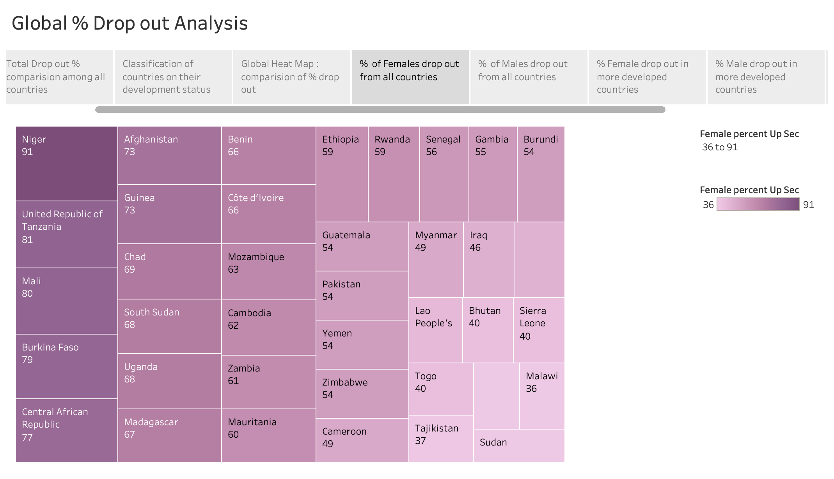

Slide 8
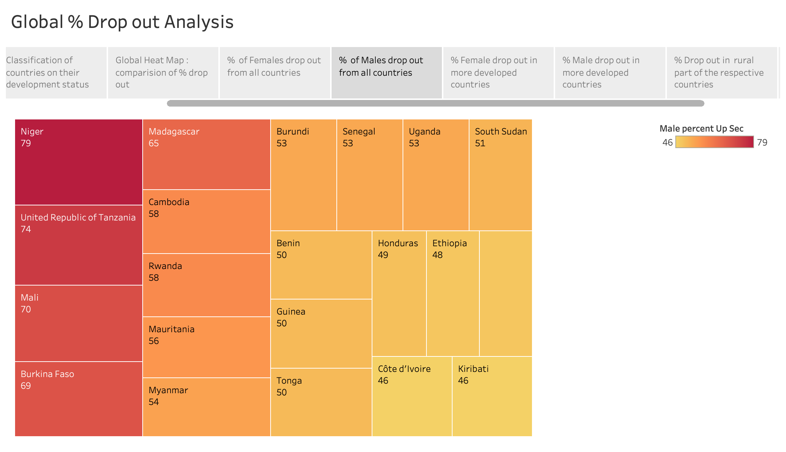

Slide 9
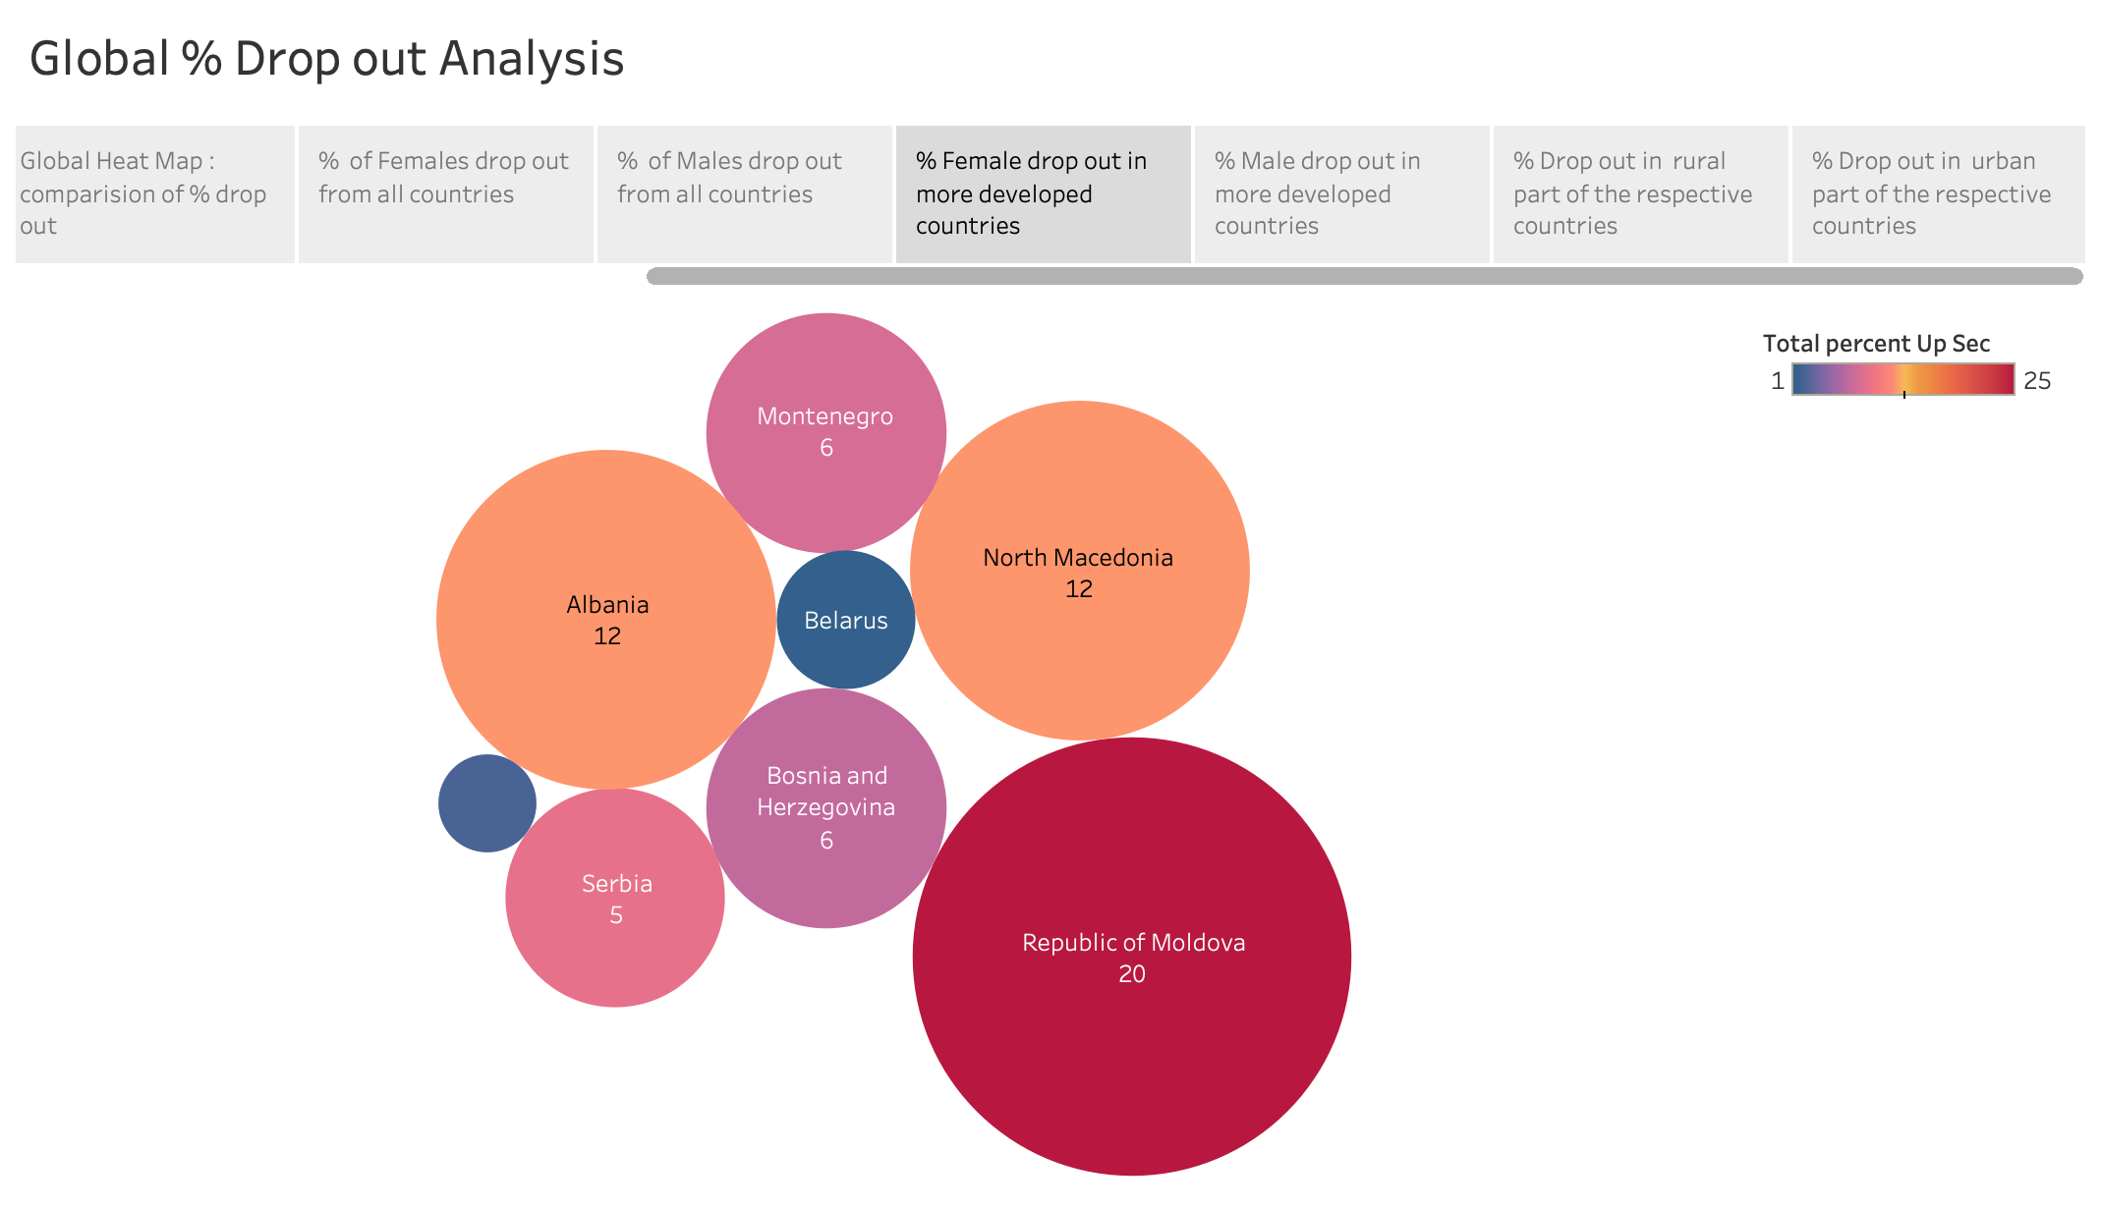

Slide 10
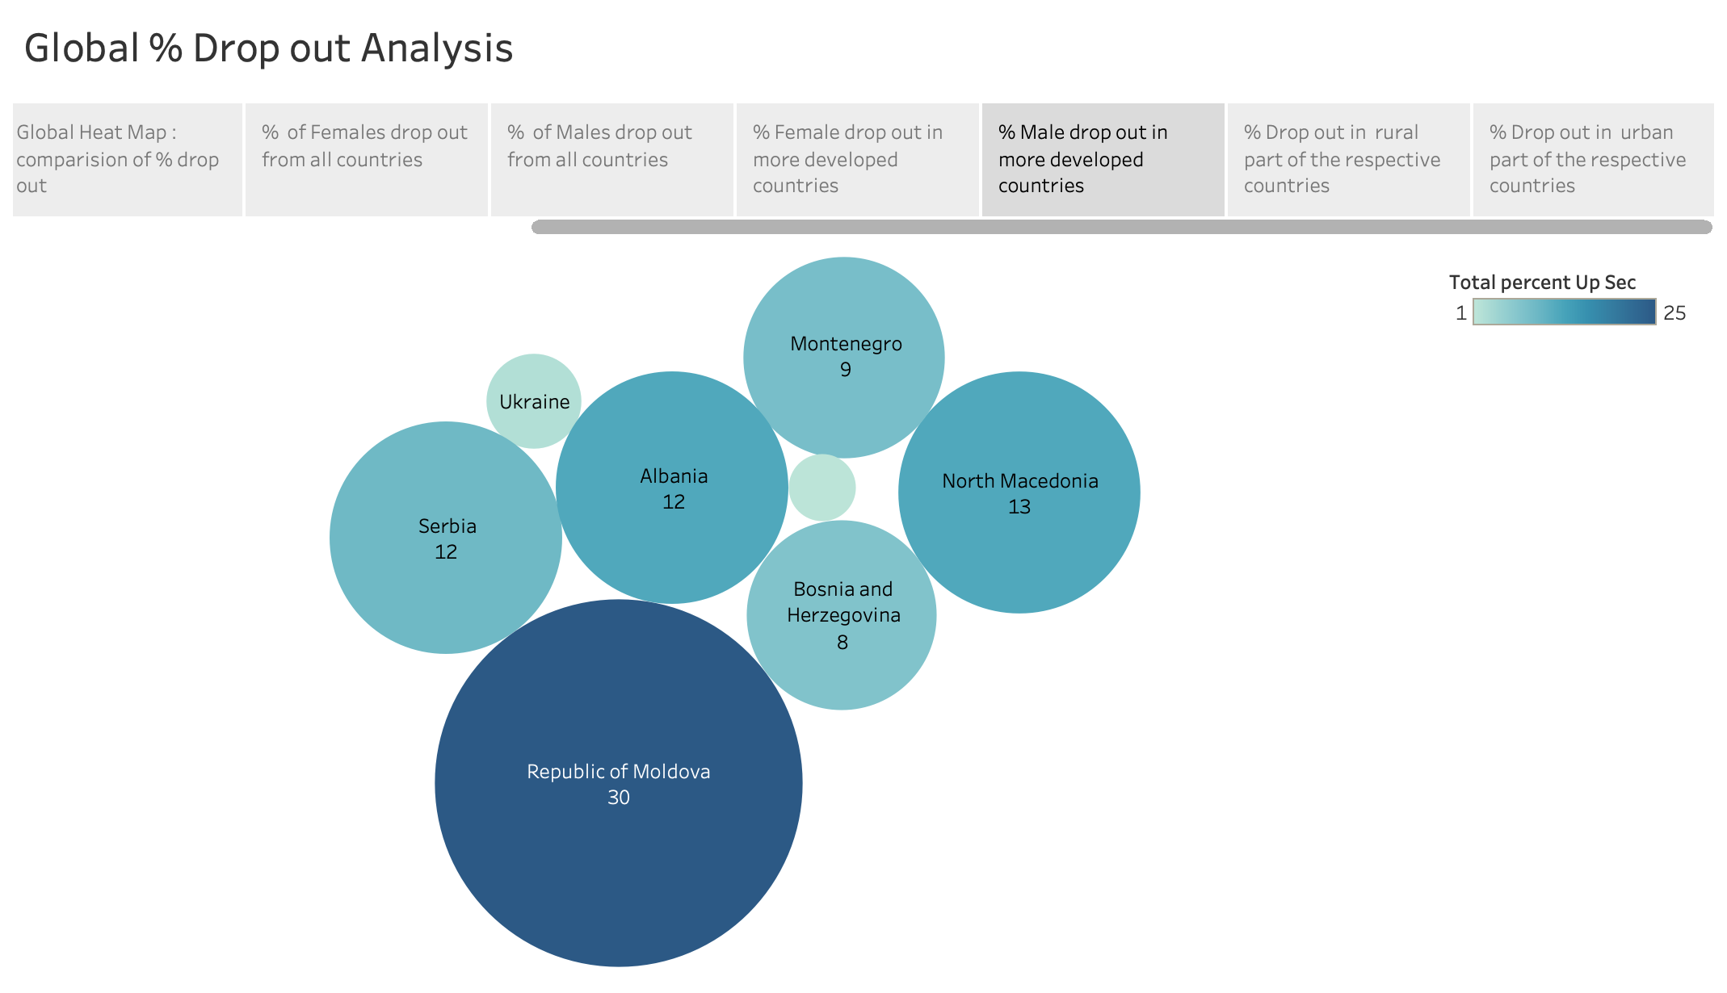

Slide 11
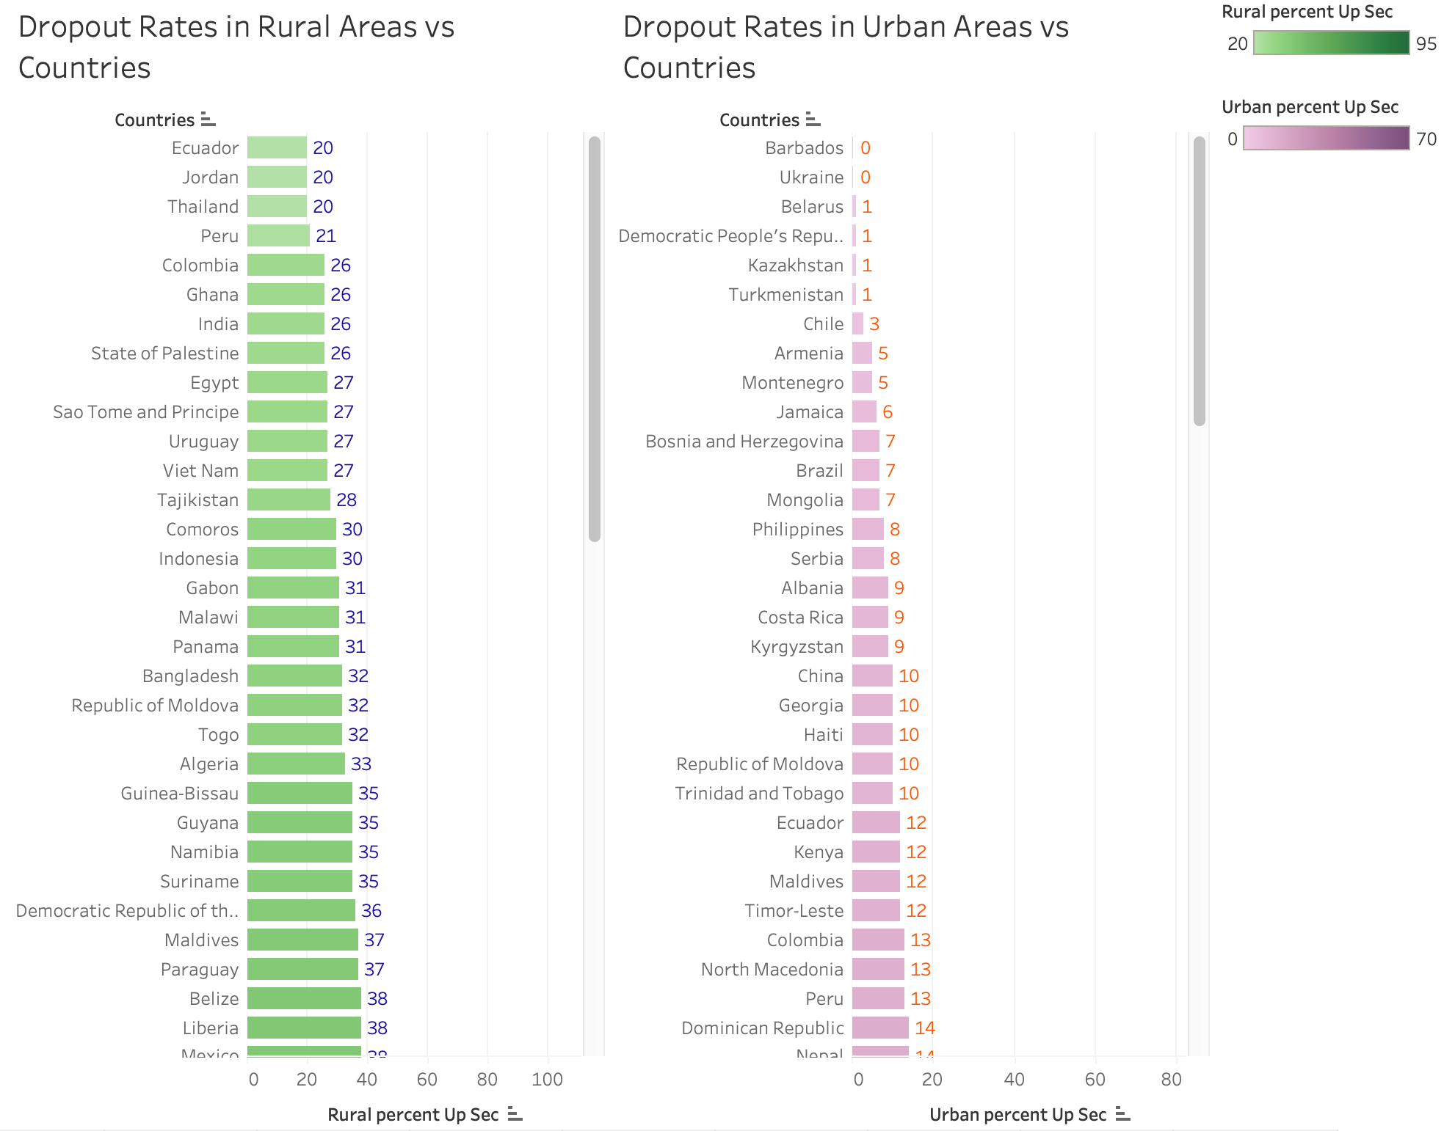

Slide 12
Conclusion drawn from analysis :
Data source link : https://www.kaggle.com/datasets/komalkhetlani/out-of-school-rates-global-data?select=Upper+Secondary.csv
Niger has the highest total school dropout rate, female dropout rate and male dropout rate.
Some other countries with highest school dropout rates are Tanzania, Mali and Madagascar.
Countries with lowest school dropout rates are Belarus, Barbados, South Korea and Turkmenistan.
Most countries have higher dropout rates in rural areas compared to urban areas. Some Exceptions are Eswatini, Kenya and South Africa.
63% of countries have more female dropouts than male dropouts. Some exceptions are Kiribati, Mongolia, Philippines, Moldova, Serbia, Thailand, Palestine and Tonga.
Countries having equal rates of male and female dropouts are Chile, Albania, Nepal, Paraguay and El Salvador.
India has a relatively low drop our rate i.e. 23 %. Female Dropout rate is 5% more than Male Dropout rate and Dropout rate in Rural Areas is 9% more than the dropout rate in Urban Areas.

